Slide 1
Lesson 5
Sensors in Remote Sensing

Slide 2
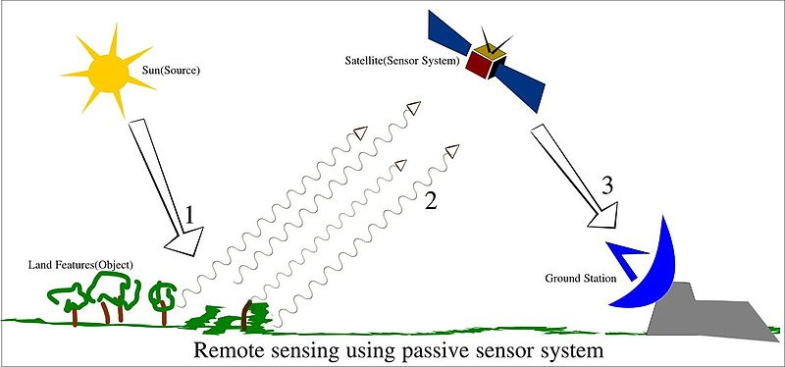
Remote sensing sensors collect data by detecting the energy that is reflected from Earth. These sensors can be on satellites or mounted on aircraft. Remote sensors can be either passive or active. Passive sensors respond to external stimuli. They record natural energy that is reflected or emitted from the Earth's surface.

Slide 3
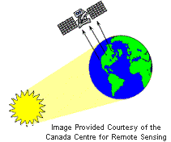
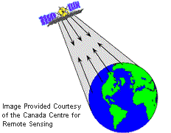
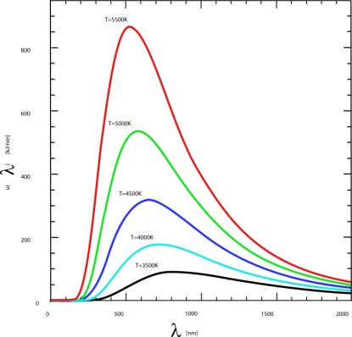
SENSORS: Passive and Active Remote Sensing Sensor
Remote sensing instruments are of two primary types
Passive (VIS, IR, MW)
Active (optical,MW)
Passive sensors detect natural energy (radiation) that is emitted or reflected by the object
The sensor that detects and measures the radiation that is reflected or backscattered from the target.
Links:
http://www.csc.noaa.gov/products/nchaz/htm/ccap5.htm

Slide 4
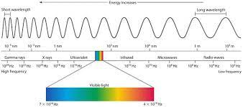
Optical/IR remote sensing ( 0.4 to 8.0 micrometer)
Thermal remote sensing ( 8 to 12 micrometer)
Microwave remote sensing ( .3 to 100 GHz)

Slide 5
1) Visible / near / mid infrared
  Passive measurements
    solar energy reflected by the surface
    determine surface (spectral) reflectance
  Active measurement
    LIDAR - active laser pulse
    time delay (height)
http://ecoursesonline.iasri.res.in/mod/page/view.php?id=124941

Slide 6
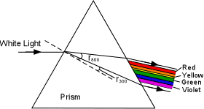
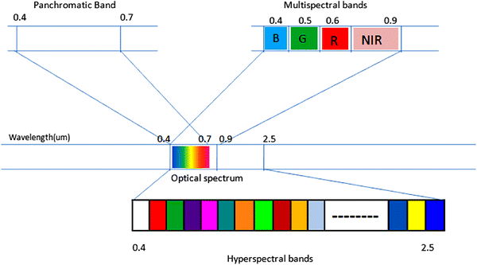
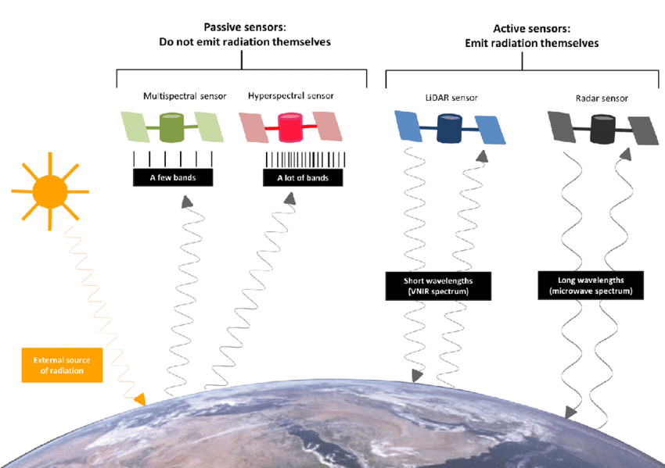

Slide 7
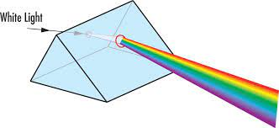
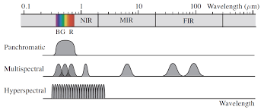
Received reflected light can be acquired in different manners

Slide 8
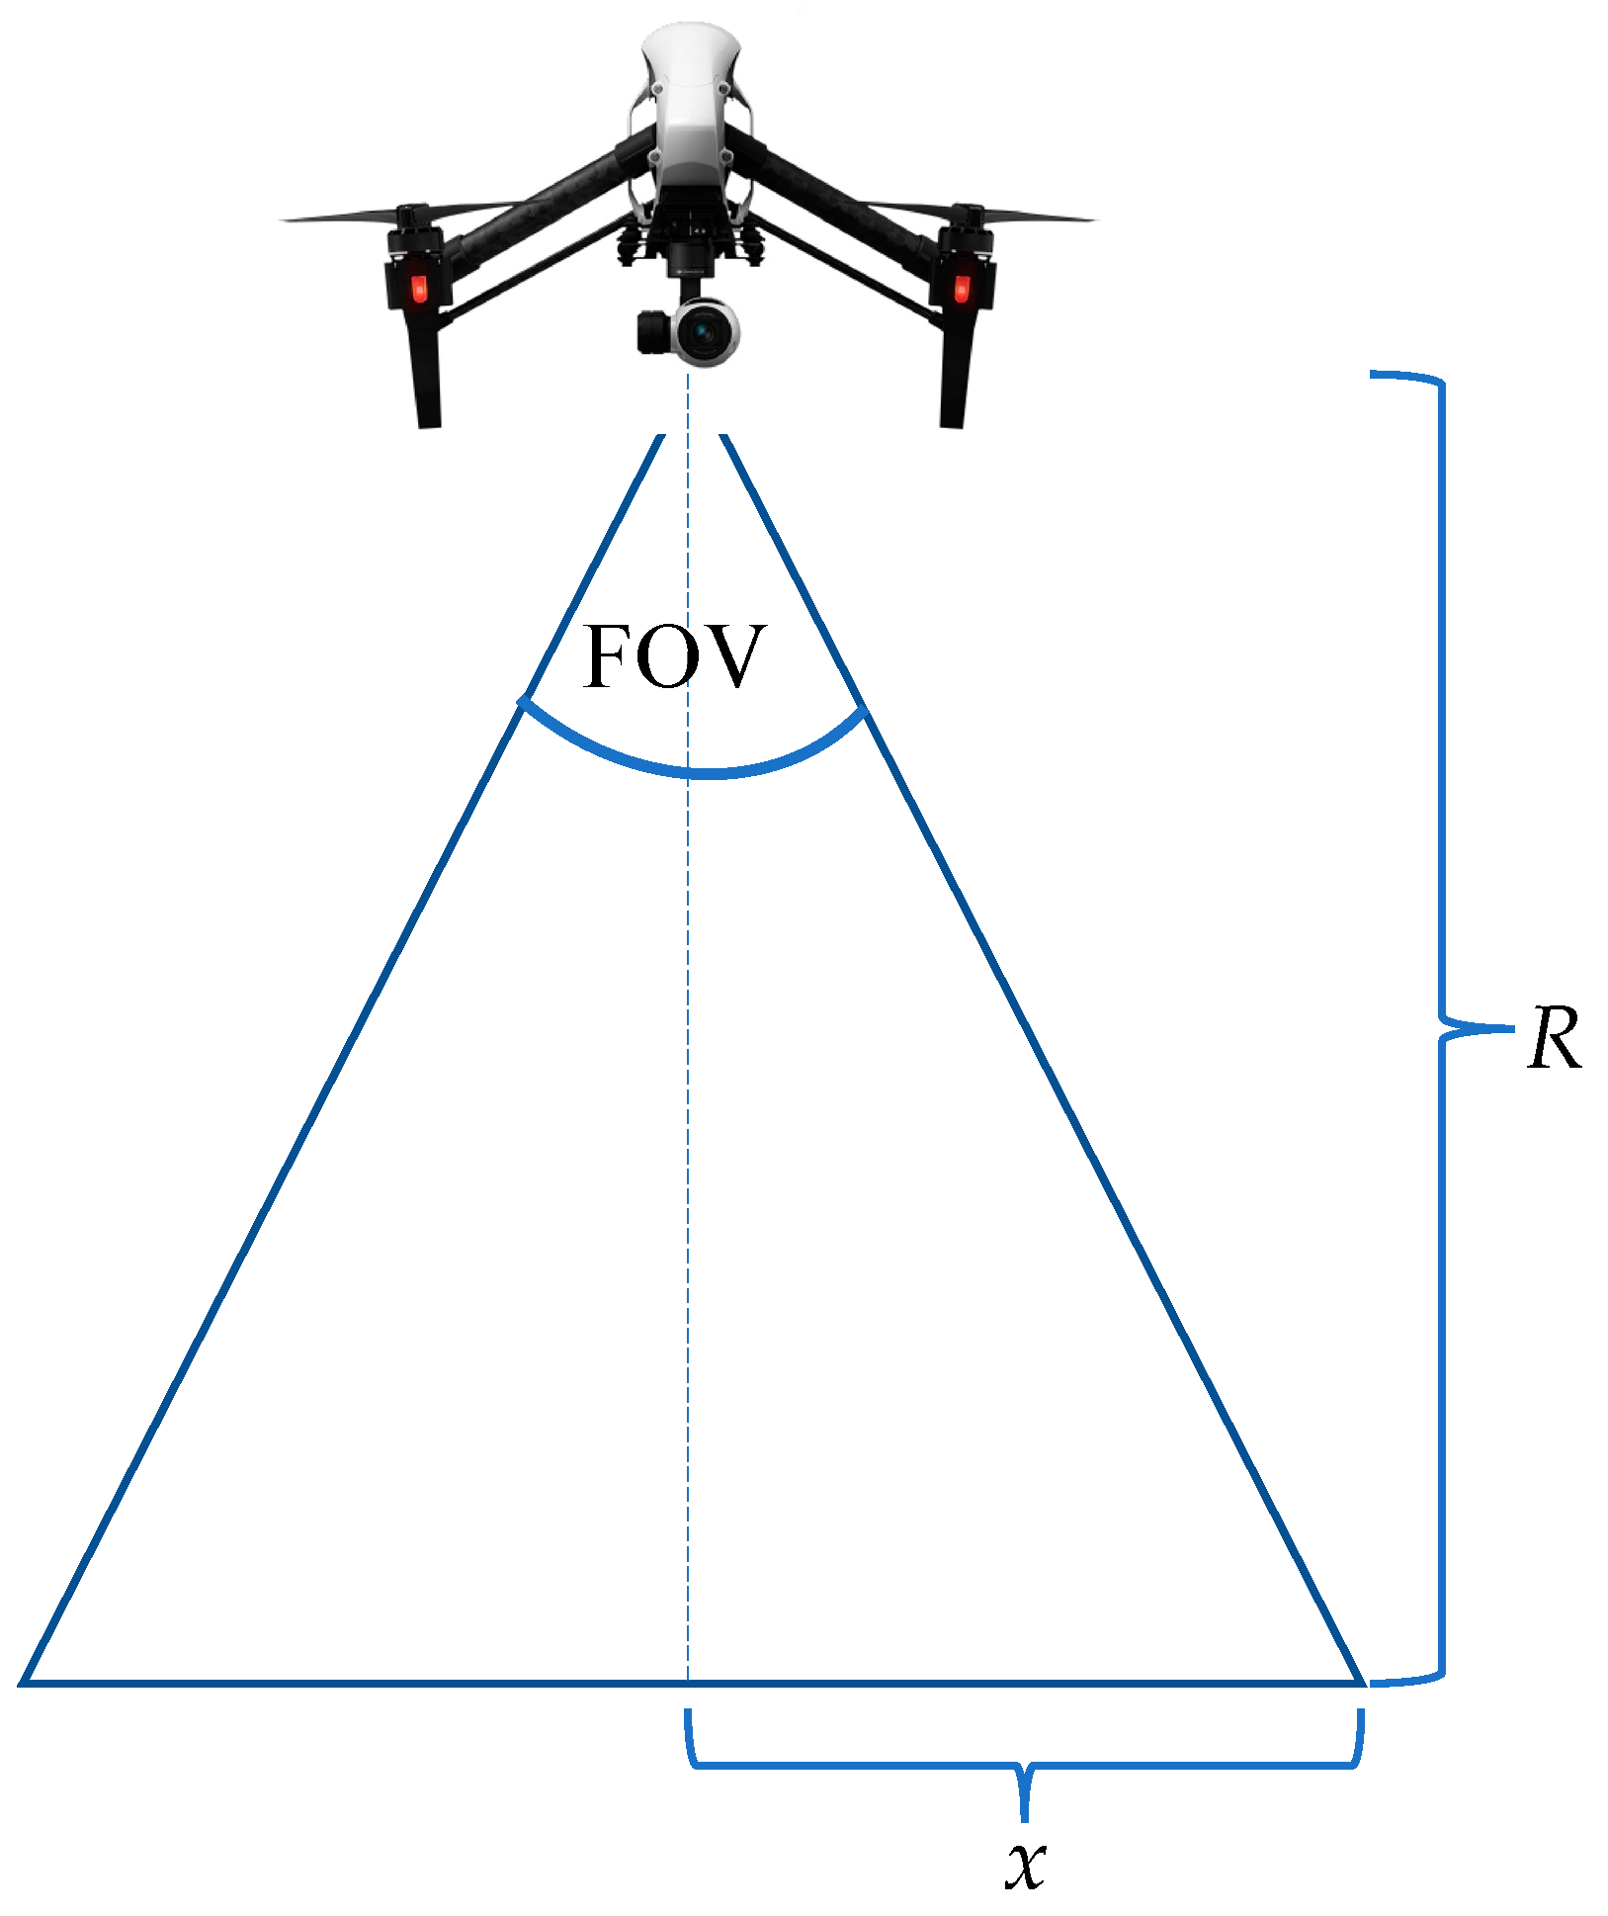
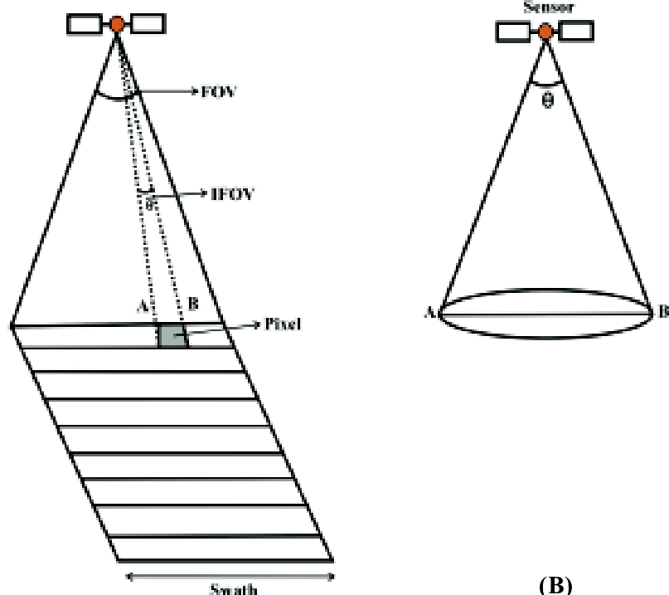

Slide 9
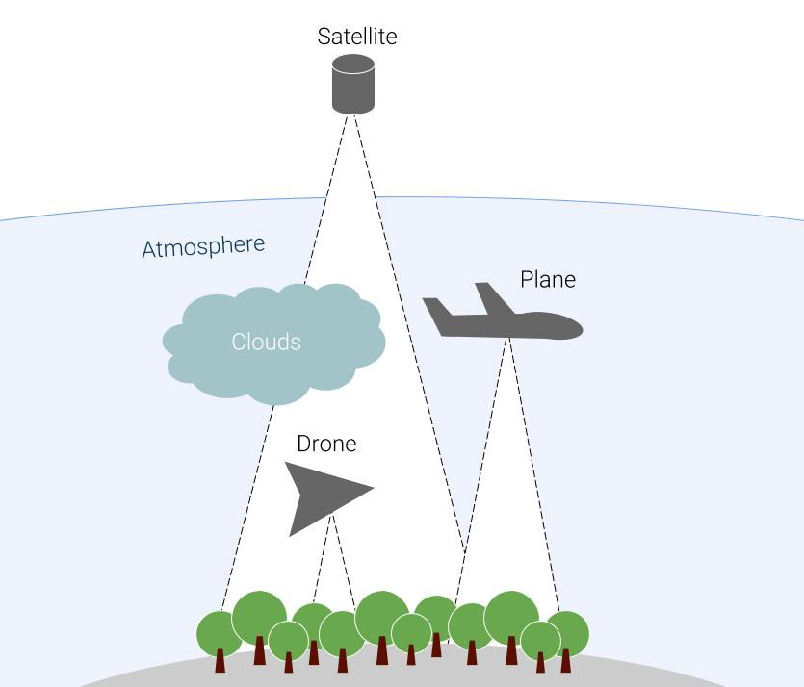
PLATFORM
Satellite: 400 to 1000 km
Airborne: 3 km to 10 km
Drone:150 m to 500 m

Slide 10
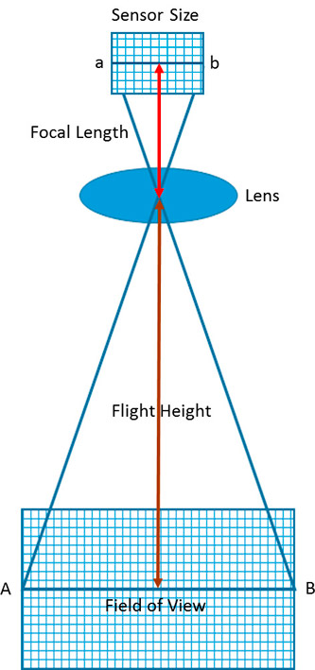

Slide 11
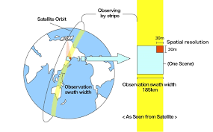
IFOV
WHAT IS IMAGE SWATH?

Slide 12
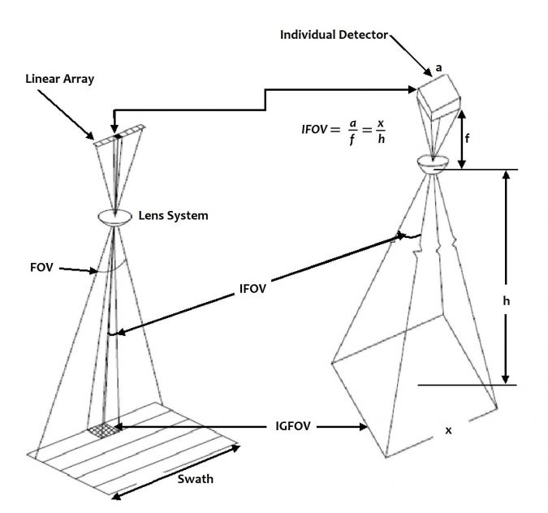
IFOV (Instantaneous Field of View) A measure of the spatial resolution of a remote sensing imaging system. Defined as the angle subtended by a single detector element on the axis of the optical system.
The IFOV characterizes the sensor, irrespective of the altitude of the platform. The field of view (FOV) is the total view angle that defines the swath

Slide 14
Resolution= IFOV* Height
For IFOV= 1 mrad, H=10 km
Resolution= 10 m

Slide 15
Shades are representative of DN Values in the image

Slide 16
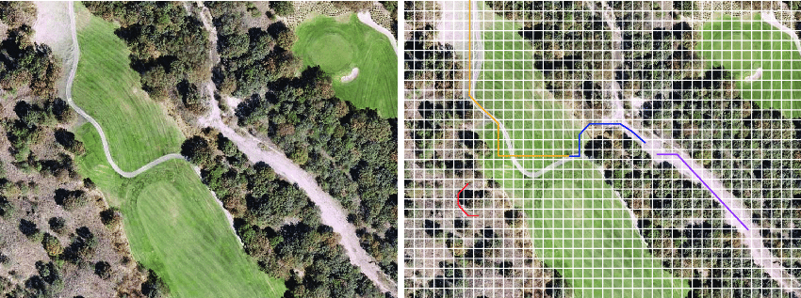

Slide 17
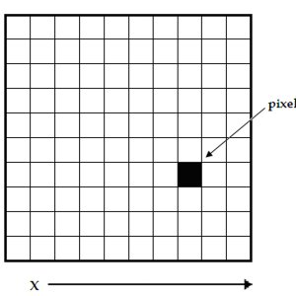
What is Pixel?
The smallest unit of information in an image or raster map, usually square or rectangular. Pixel is often used synonymously with cell.
In remote sensing, the fundamental unit of data collection.
A pixel is represented in a remotely sensed image as a cell in an array of data values.

Slide 18
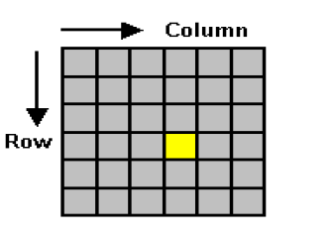
IMAGING METHODS
Frame by Frame
Pixel by pixel
Line by line

Slide 19
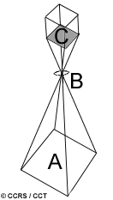
http://www.nrcan.gc.ca/earth-sciences/geomatics/satellite-imagery-air-photos/satellite-imagery
-products/educational-resources/9351
Cameras and their use for aerial photography are the simplest and oldest of sensors used for remote sensing of the Earth's surface. Cameras are framing systems which acquire a near-instantaneous "snapshot" of an area (A), of the surface. Camera systems are passive optical sensors that use a lens (B)(or system of lenses collectively referred to as the optics) to form an image at the focal plane (C), the plane at which an image is sharply defined.
Photographic films:0.3 μm to 0.9 μm in wavelength covering the ultraviolet (UV),
visible, and near-infrared (NIR).
Panchromatic films are sensitive to the UV and the visible portions of the spectrum

Slide 20
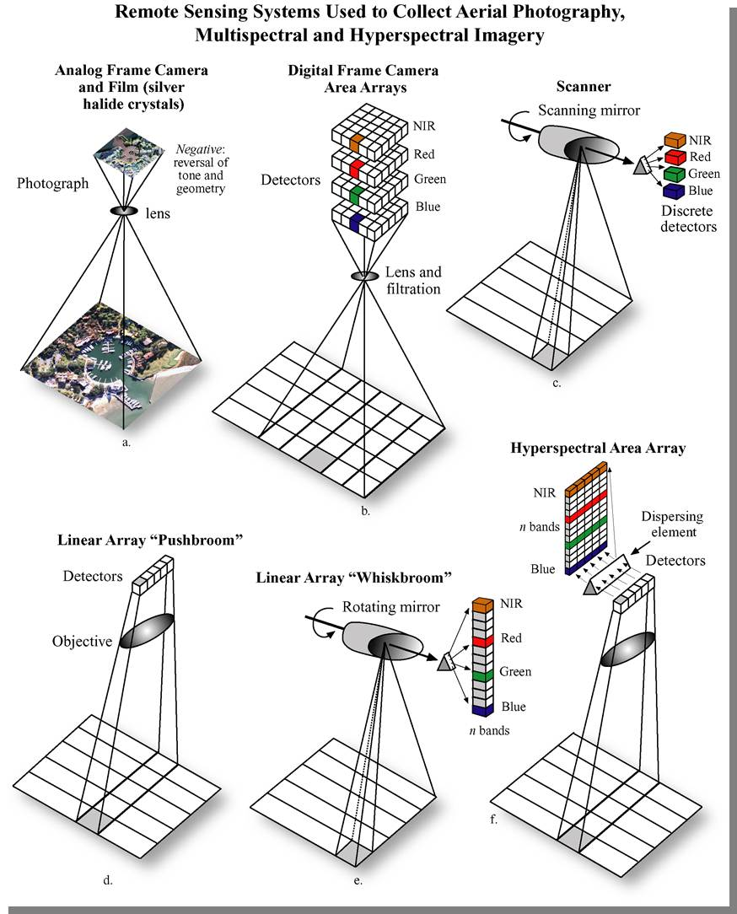
Frame by Frame

Slide 21
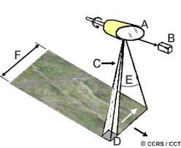
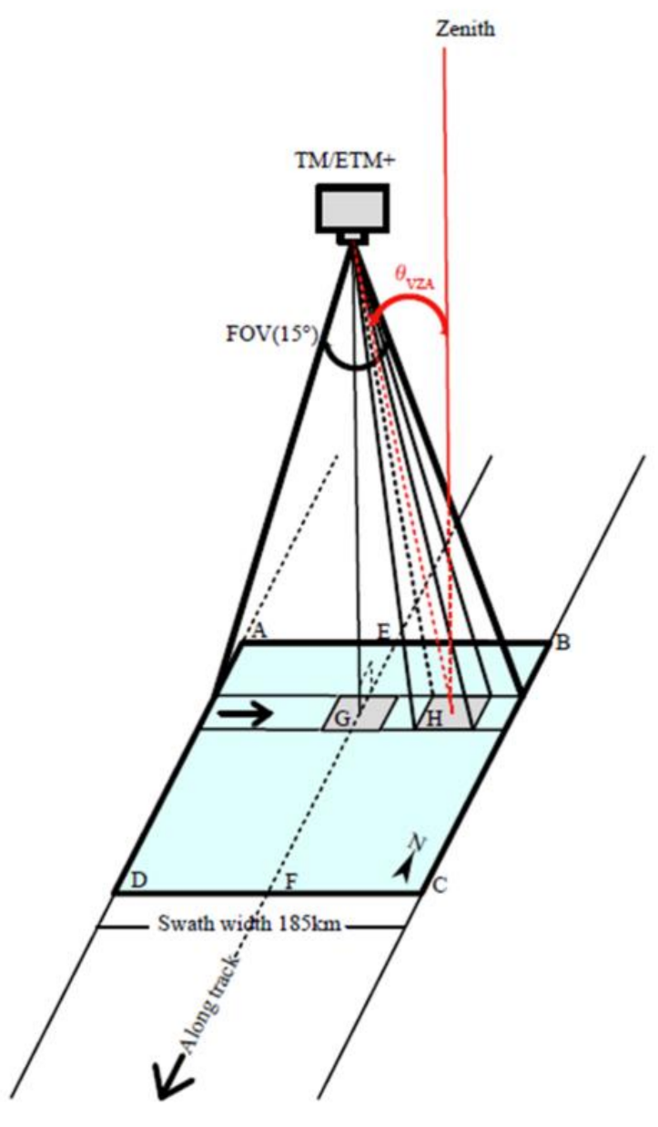

PIXEL BY PIXEL
Resolution= IFOV* Height
For IFOV= 1 mrad, H=10 km
Resolution= 10 m

Slide 22
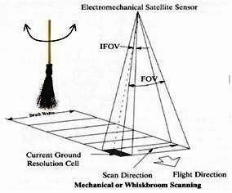
Multispectral scanners measure reflected electromagnetic energy by scanning the Earth’s surface. This results in digital image data, of which the elementary unit is a picture element, a pixel. As the name multispectral suggests, the
measurements are made for different ranges of the EM spectrum.
MULTISPECTRAL SCANNER
A combination of a single detector plus a rotating mirror can be arranged in such
a way that the detector beam sweeps in a straight line over the Earth across the
track of the satellite at each rotation of the mirror

Slide 23
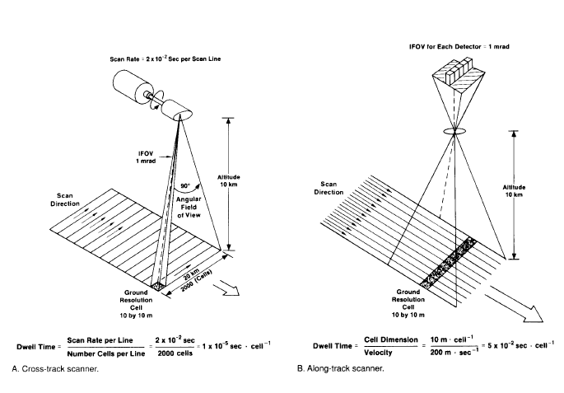
Wiskbroom
Resolution= IFOV* Height
For IFOV= 1 mrad, H=10 km
Resolution= 10 m
Across track scanner
A combination of a single detector
plus a rotating mirror can be
arranged in such a way that the
detector beam sweeps in a straight
line over the Earth across the
track of the satellite at each rotation
of the mirror
Wiskbroom
Sabin, 1997
Field of View (FOV), Instantaneous Field of View (IFOV)
Dwell time is the time required for the detector IFOV to sweep across a ground cell. The longer
dwell time allows more energy to impinge on the detector, which creates a stronger signal.

Slide 24
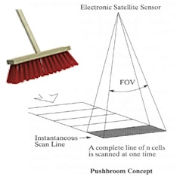
Along-track or Pushbroom scanning
These sensors do not use opto-mechanical device and have no moving parts.
The energy coming from ground directly falls on the array of charge-coupled devices {CCD), which calibrate the received energy and change it to digital counts.
This method allows sensing of energy for larger time and hence results in better signal.
• GIFOV :- Ground projected instenteneous FOV
• GSI :- Ground projected sample interval
• FOV :- Field of view
• IFOV :- Instenteneous field of view
• GFOV :- Ground projected field of view

Slide 25
Pushbroom
Sabin, 1997
Wiskbroom
ALONG TRACK SCANNER
Field of View (FOV), Instantaneous Field of View (IFOV)
Dwell time is the time required for the detector IFOV to sweep across a ground cell. The longer
dwell time allows more energy to impinge on the detector, which creates a stronger signal.

Slide 26
Remote Sensing Scanning System
Sabin, 1997
Wiskbroom
Pushbroom
Field of View (FOV), Instantaneous Field of View (IFOV)
Dwell time is the time required for the detector IFOV to sweep across a ground cell. The longer
dwell time allows more energy to impinge on the detector, which creates a stronger signal.

Slide 27
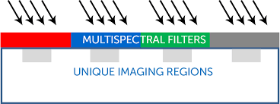
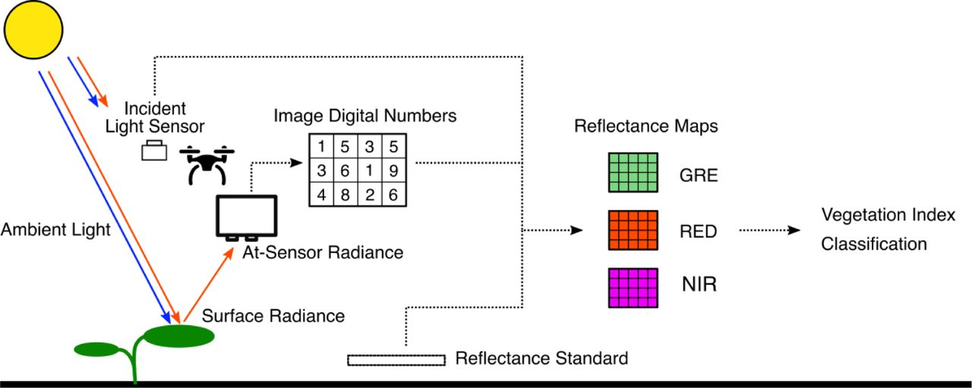
A multispectral imager is one that captures image data within specific wavelength ranges across the electromagnetic spectrum. ... Multispectral imaging measures light in a small number (typically 3 to 15) of spectral bands.
Multispectral remote sensing is generally based on acquisition of image data of Earth's surface simultaneously in multiple wavelengths.

Slide 28
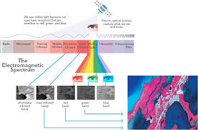

Slide 29
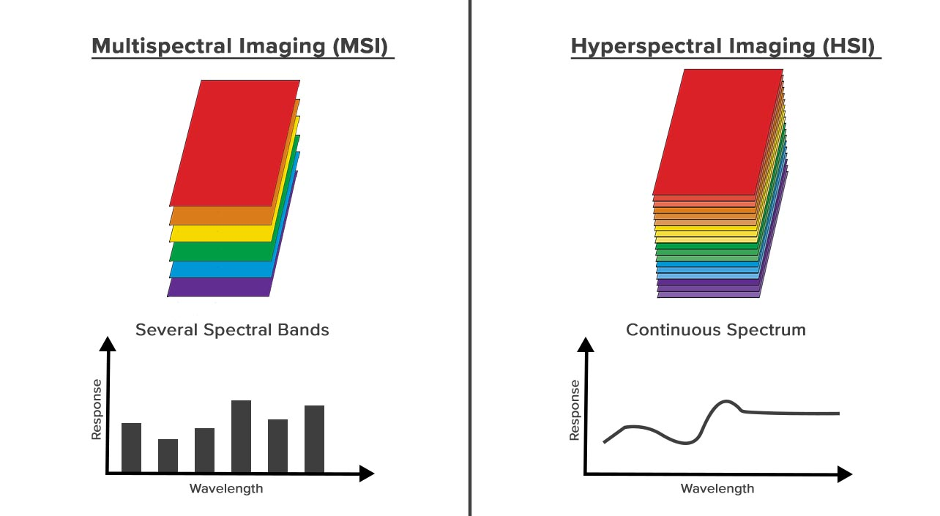

Slide 30
QUESTION BANK
Explain working principle of multispectral imager
Difference between along whiskbroom and pushbroom multispectral resolution

